Slide 1
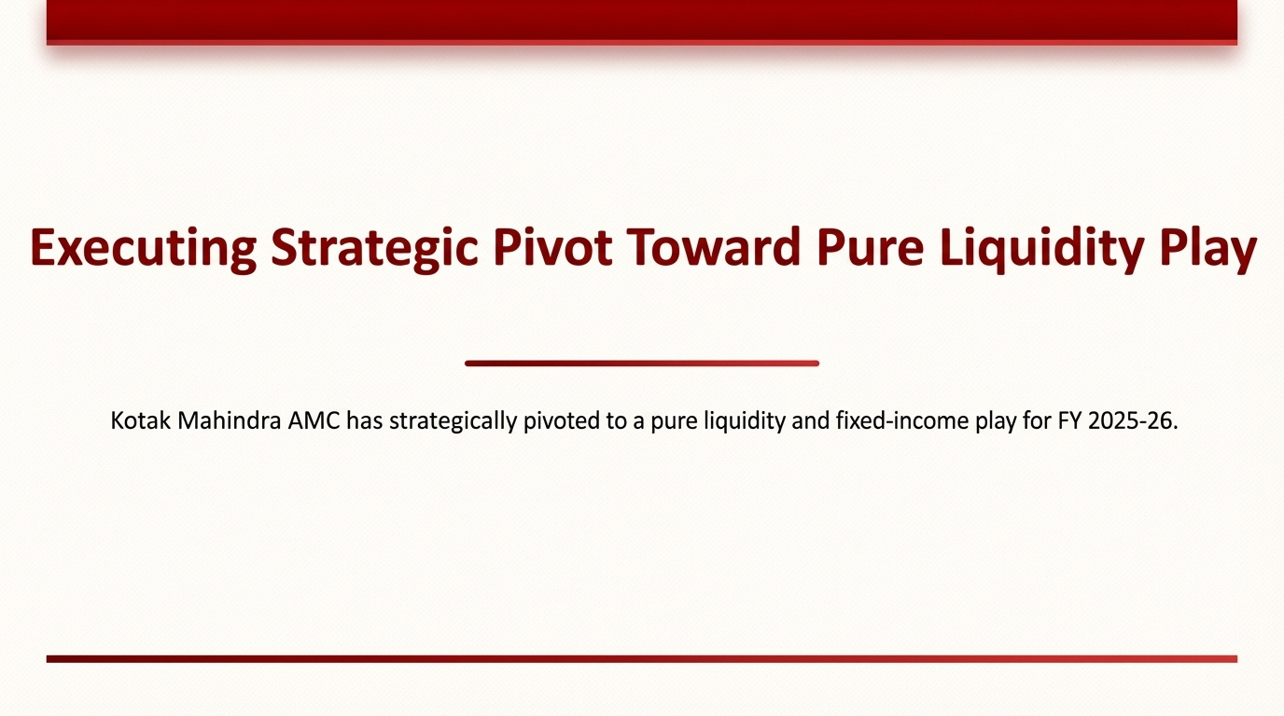

Slide 2
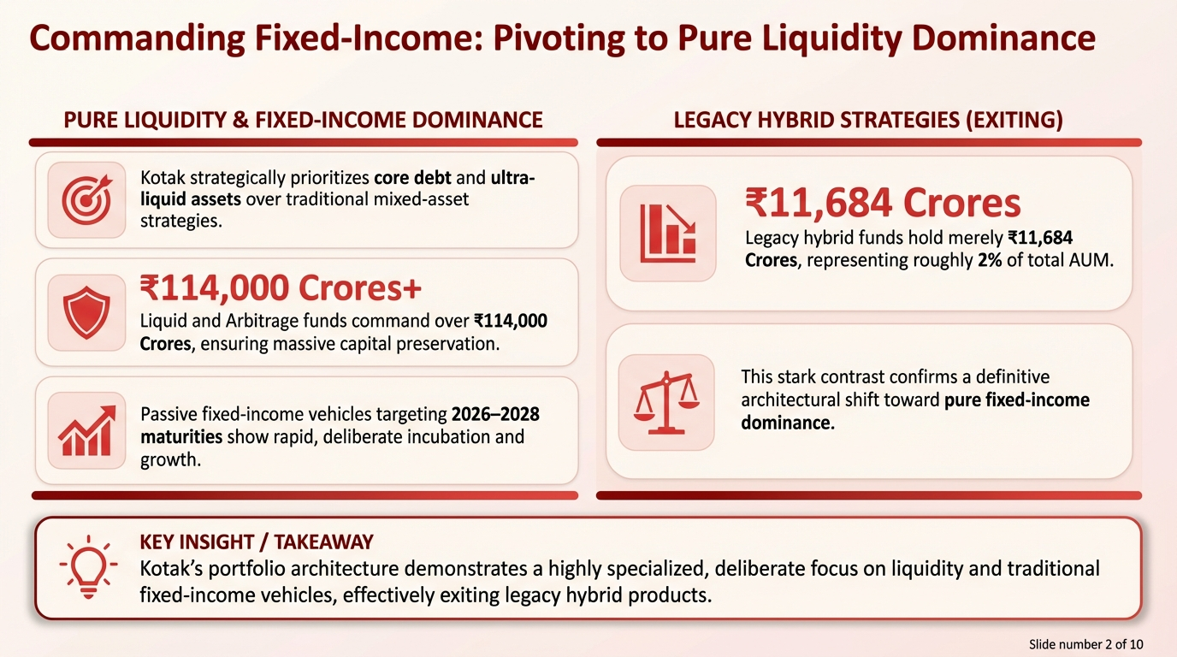

Slide 3
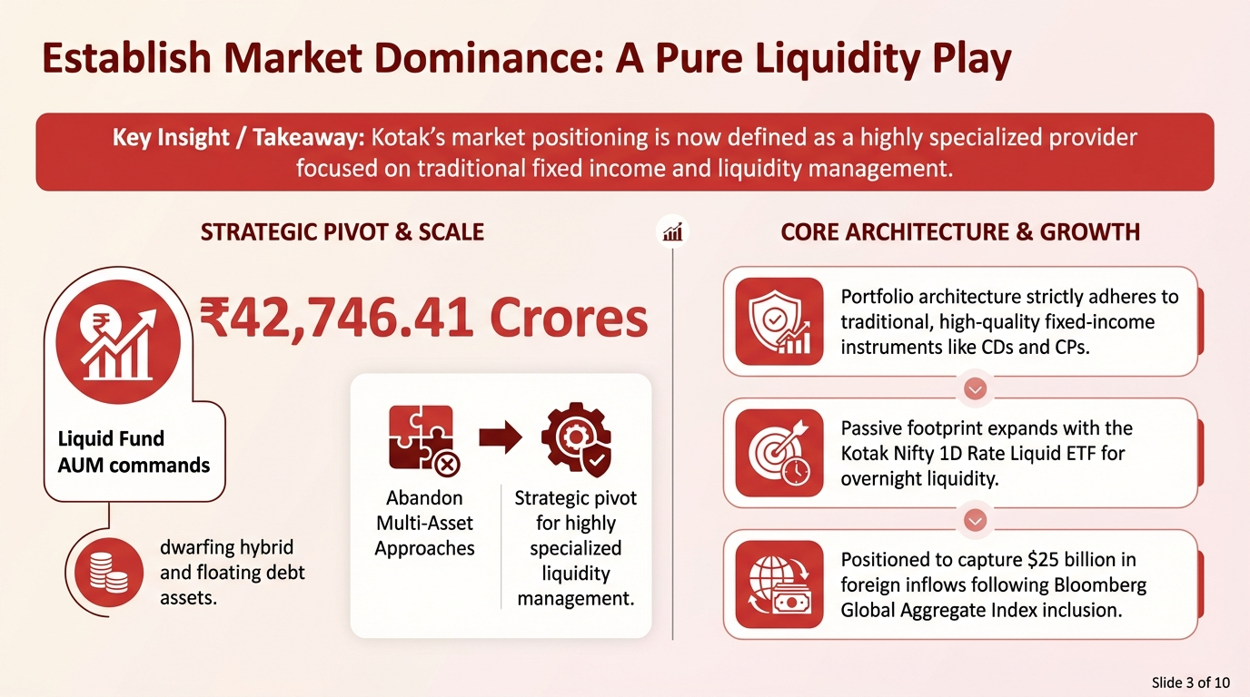

Slide 4
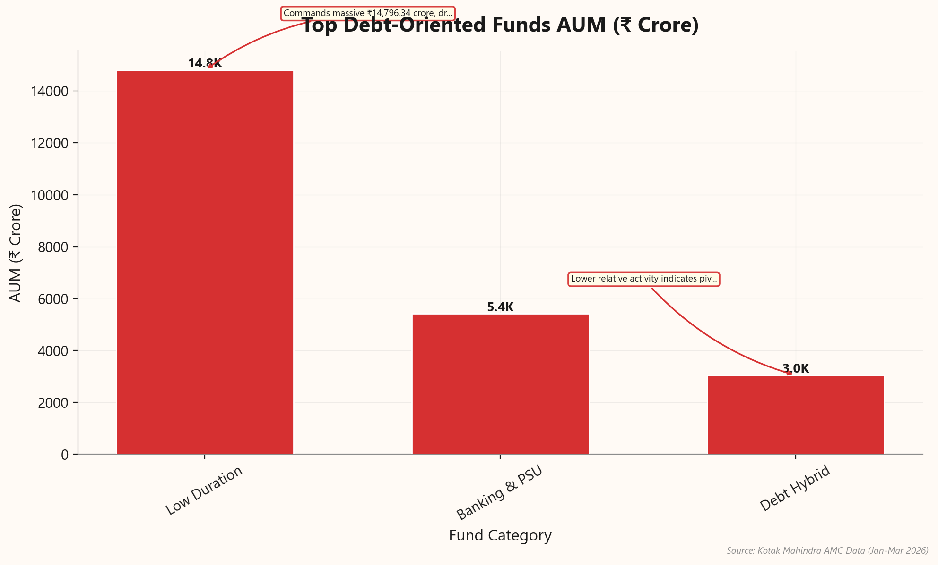
Capitalize on Massive Debt Instrument Concentration
▸ Overwhelming reliance on fixed-income vehicles ensures portfolio stability amidst global market volatility.
▸ Volume for these specific assets stands near 4.28 million distinct investor allocations.
▸ Strategic focus targets pure liquidity, capturing thirty-seven percent from overall ₹6 lakh crore AUM.
▸ Systematic inflows continuously replenish this ecosystem, providing steady capital streams.
★ KEY INSIGHT: The overarching defining characteristic of Kotak's asset distribution is its 4.28 million concentration in Debt-related instruments.
Kotak Mahindra AMC: Competitive Intelligence & Ass...
Slide 4 of 10

Slide 5
Concentrate Debt Assets in Core and Liquid Vehicles
Asset Sub-Category | Percentage of Total Debt Segment | Strategic Role
Core Debt | 56.9% | Primary Fixed-Income Driver
Ultra Liquid | 31.8% | Primary Liquidity Driver
Other Debt Vehicles | 11.3% | Emerging/Passive Strategies
Total Debt Segment | 100.0% | Aggregate Debt Portfolio
Source: Kotak data dump.xlsx (Internal Data Analysis, FY 2025-26)
💡 Core Debt and Ultra Liquid funds drive 88.7% of the total debt portfolio.
Kotak Mahindra AMC: Competitive Intelligence & Ass...
Slide 5 of 10

Slide 6
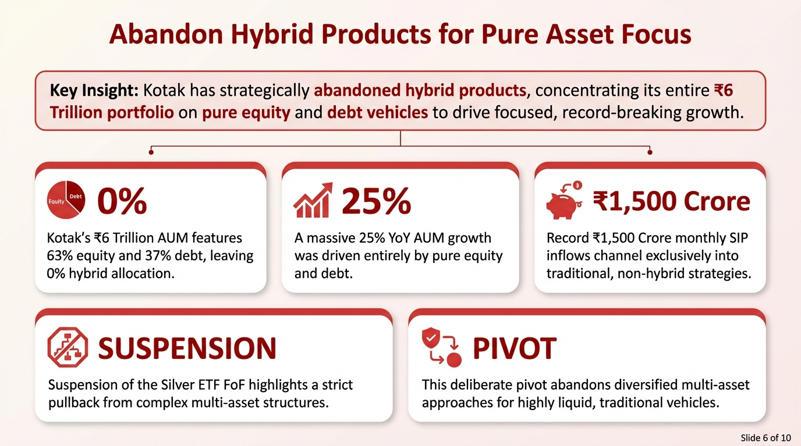

Slide 7
Harness the Strategic Shift Toward Passive Debt
Asset Category | Unit Volume | Strategic Status
Core Debt & Ultra Liquid | Primary Majority | Core Focus / High Concentration
Index Debt (Passive) | 290,480 | Emerging Secondary Category
Hybrid Funds | 0 | Deprioritized / Negligible
Assured-Return | 0 | Deprioritized / Negligible
Source: Kotak data dump.xlsx / Internal Research Synthesis Report
💡 Index Debt has rapidly scaled to 290,480 units, signaling a definitive pivot toward passive strategies.
Kotak Mahindra AMC: Competitive Intelligence & Ass...
Slide 7 of 10

Slide 8
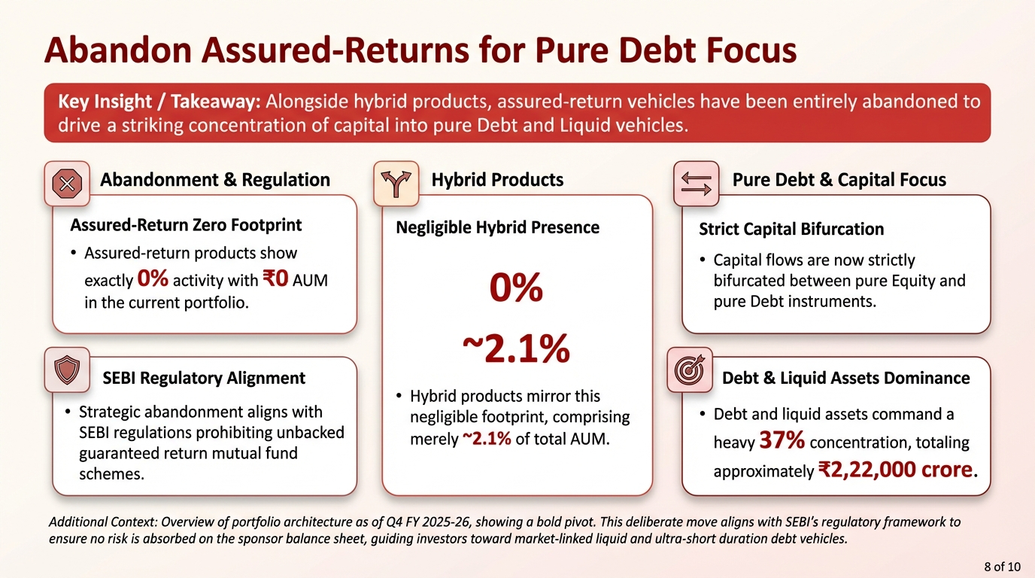

Slide 9
Contrast Kotak's Immense Debt Against Negligible Blended Portfolios
Asset Class | Total AUM (Cr) | Corporate AUM (Cr) | Direct Plan AUM (Cr) | Regular Plan AUM (Cr)
Equity | 9,450,066 | 1,130,219 | 2,135,987 | 6,877,987
Debt | 3,738,027 | 2,562,532 | 2,343,743 | 1,305,765
Liquid | 3,441,792 | 3,051,384 | 2,762,018 | 615,810
Ultra Liquid | 3,402,664 | 2,775,653 | 2,533,298 | 789,433
Arbitrage | 2,618,165 | 1,183,057 | 1,462,249 | 1,042,796
Hybrid | 1,887,795 | 266,003 | 248,964 | 1,509,758
ETF Equity | 800,283 | 791,968 | 679,383 | 119,079
Index Debt | 462,213 | 290,480 | 314,705 | 131,902
FMP | 460,254 | 329,612 | 361,286 | 62,509
Equity-NA | 292,082 | 65,502 | 74,833 | 193,432
ETF Gold | 271,247 | 267,632 | 264,880 | 6,366
Fund of Funds Scheme (Domestic) | 251,136 | 65,206 | 105,912 | 141,063
Debt-NA | 212,574 | 144,849 | 115,840 | 87,482
Fund Of Funds Investing Overseas | 199,427 | 53,017 | 100,499 | 69,136
Index Equity | 65,367 | 13,489 | 42,752 | 19,145
FMP-NA | 58,231 | 42,445 | 46,921 | 7,853
ETF Silver | 30,824 | 30,823 | 30,824 | 0
ETF Liquid | 20,152 | 19,692 | 20,152 | 0
Hybrid-NA | 0 | 0 | 0 | 0
Scheme Names-NA | 0 | 0 | 0 | 0
Debt (assured return)-NA | 0 | 0 | 0 | 0
Infrastructure Debt Funds-NA | 0 | 0 | 0 | 0
Grand Total | 27,662,299 | 13,083,564 | 13,644,246 | 12,979,516
Source: Kotak data dump.xlsx
Kotak Mahindra AMC: Competitive Intelligence & Ass...
Slide 9 of 10

Slide 10
